Slide 1

Identification and Validation of Cell-free DNA Methylation Biomarkers for human cancers
Shicheng Guo
Center for Precision Medicine Research
Marshfield Clinic Research Institute
04/17/2019

Slide 2
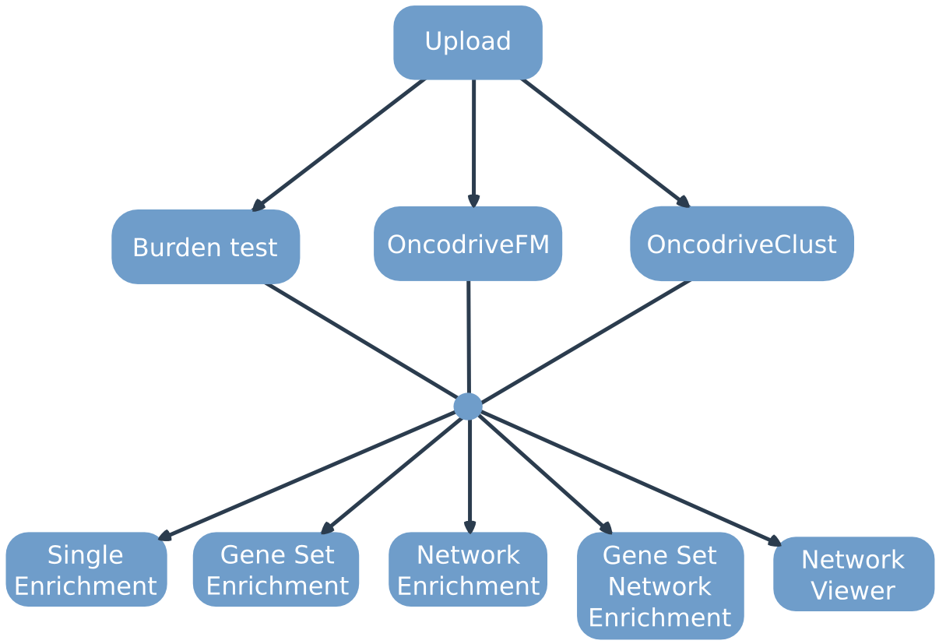

Slide 3
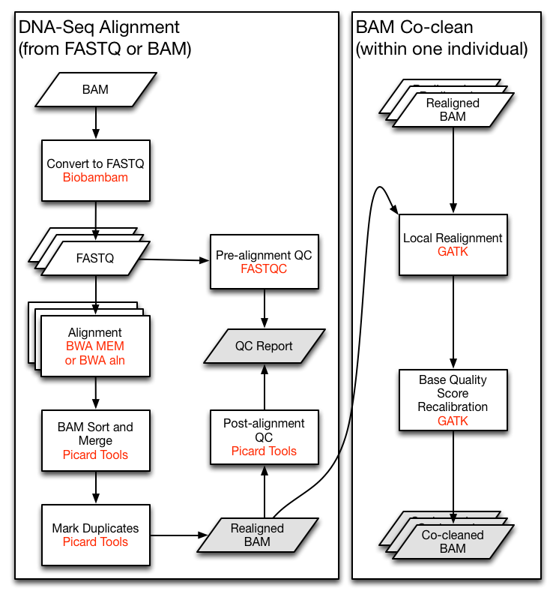

Slide 4
Counts of SNPs in Exome from Gnomad Database

Slide 5
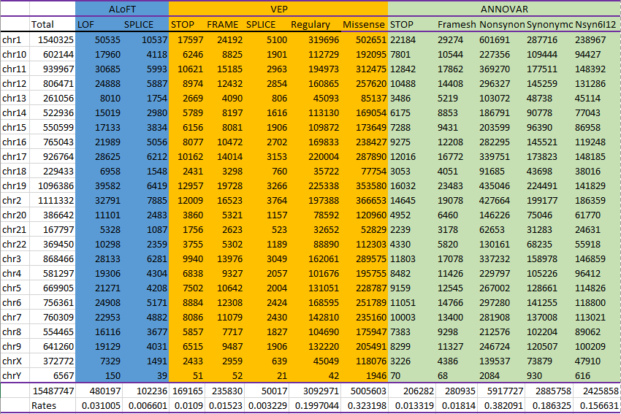

Slide 6
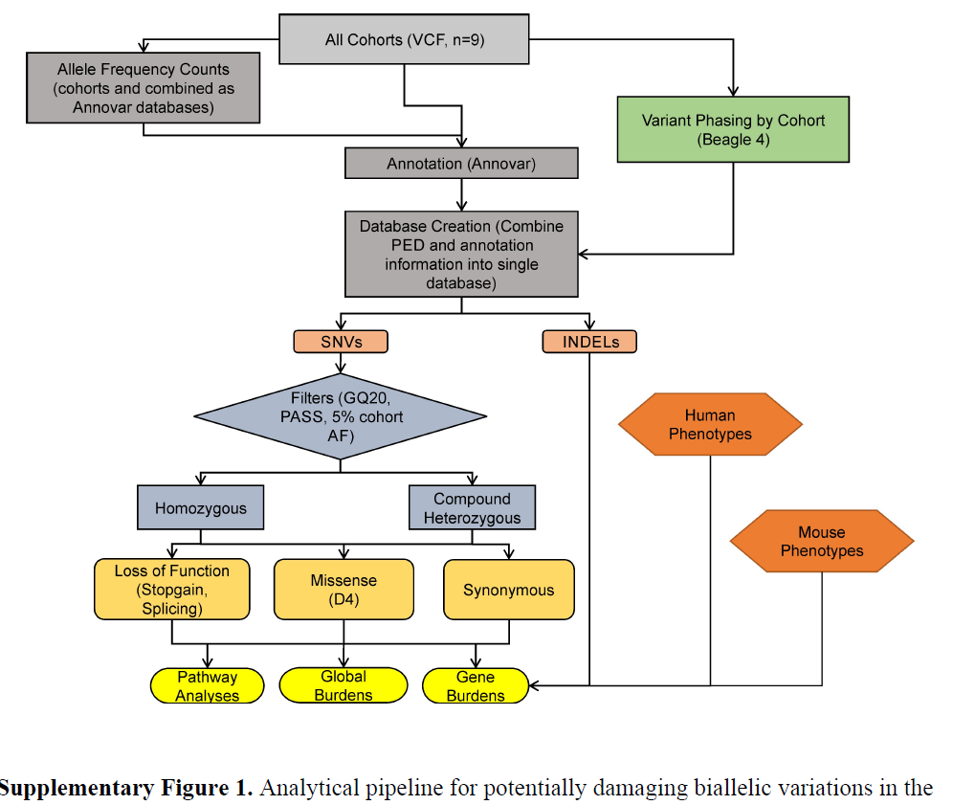

Slide 8
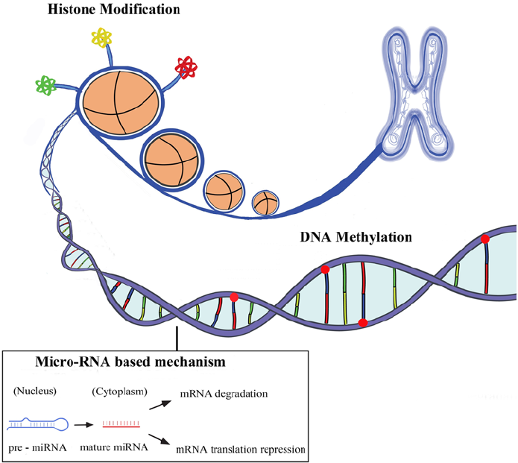
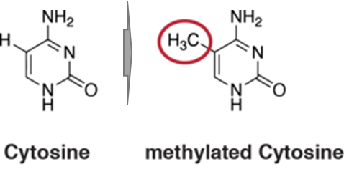
Human Genome and modification systems (Epigenetics)
DNA modification
DNA methylation
DNA hydroxymethylation
Histone modification
H3K4me1, H3K4me3
H3K27ac, H3K9ac
ncRNA system
miRNA
lncRNA
circRNA
piRNA
methyl group
Allis, Nature Review Genetics, 2016
Notes:
In most species, histone H3 is primarily acetylated at lysines 9, 14, 18, 23, and 56, methylated at arginine 2 and lysines 4, 9, 27, 36, and 79, and phosphorylated at ser10, ser28, Thr3, and Thr11. Histone H4 is primarily acetylated at lysines 5, 8, 12 and 16, methylated at arginine 3 and lysine 20, and phosphorylated at serine 1.

Slide 9
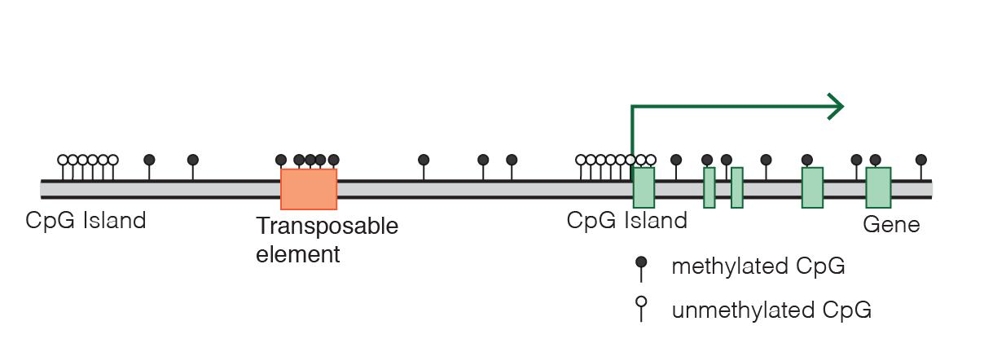
DNA methylation, gene expression and human development
DNA methylation, Wikipedia, 2019

Slide 10
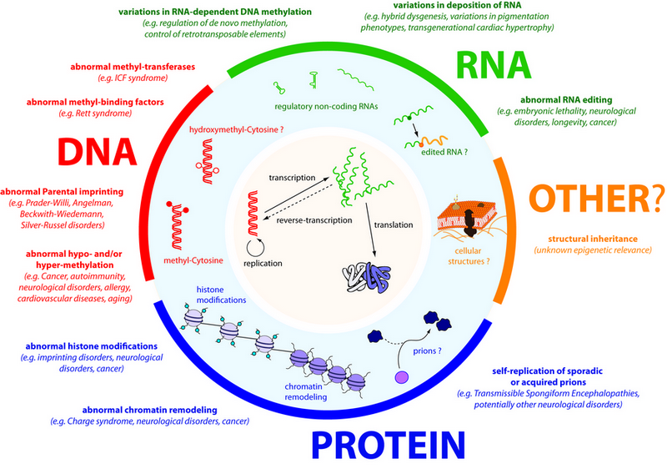
DNA methylation: best biomarkers for human diseases
Almost all diseases showed abnormal methylation change
Aging can be highly predicted by methylation clock
High sensitivity: single molecular with PCR
Stable in vitro without degradation
High tissue and status specificity
Change earlier than mRNA and protein
Easy to be assembled to a multi-disease panel
Molecular biomarker, Wikipedia, 2019

Slide 11

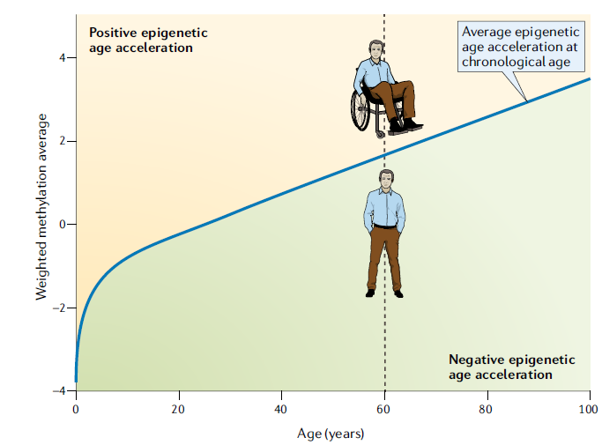
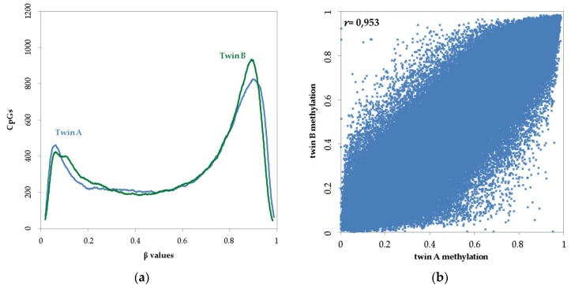
Power of DNA methylation as the distinguish biomarker
DNA ~100%
R²=0.91
DNA methylation-based age and age acceleration
Horvath, Nature Review Genetics, 2018
Guo, unpublished data
Kaminsky, Nature Genetics, 2009

Slide 12
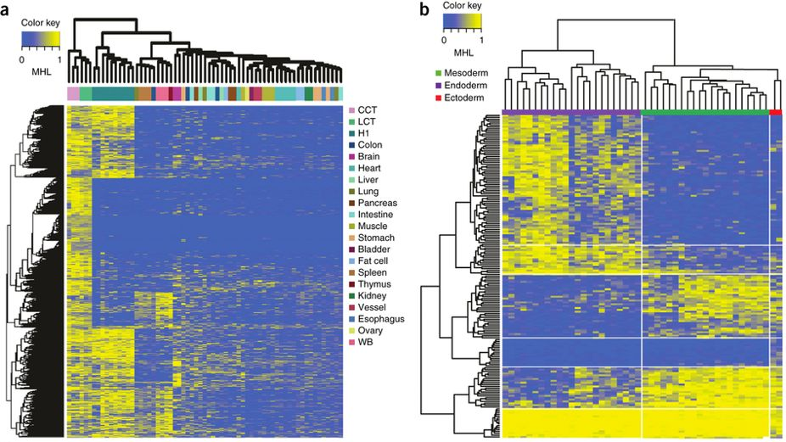
Tissue clustering based on cell-free circulating DNA methylation
Endoderm Mesoderm Ectoderm
Unsupervised clustering of human tissues using the top 15% most-variable regions from WGBS
We identified lots of germ-layer-specific methylation signals
Guo, Nature Genetics, 2017

Slide 13
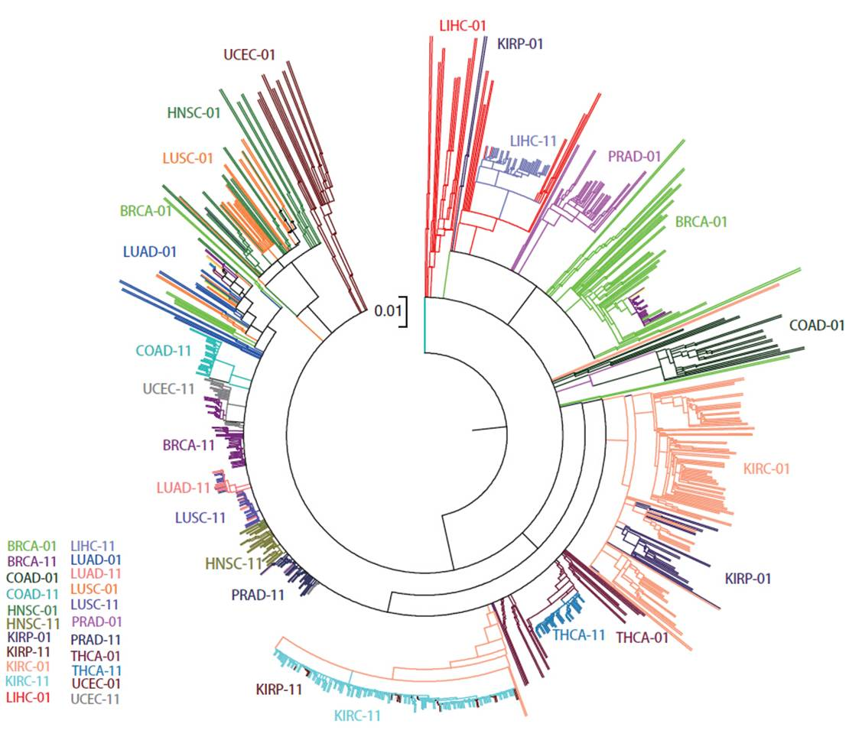
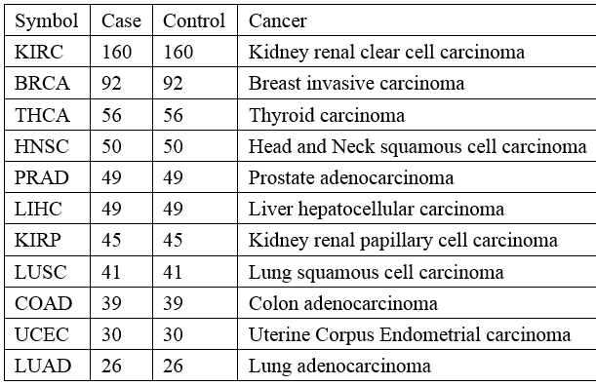

Unsupervised cluster analysis reveals cancer and normal similarity
Distance= 1-correlation
Cluster= mcquity
Pan-cancer methylation microarray dataset
11 cancer type
349,049（CpGs）$×$1278（Samples）
Guo, unpublished data

Slide 14
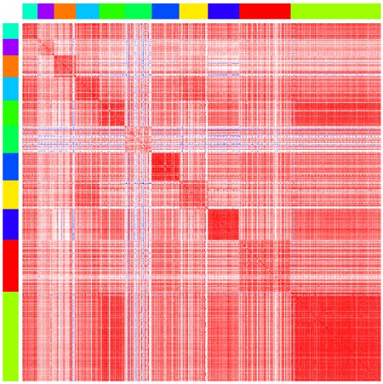
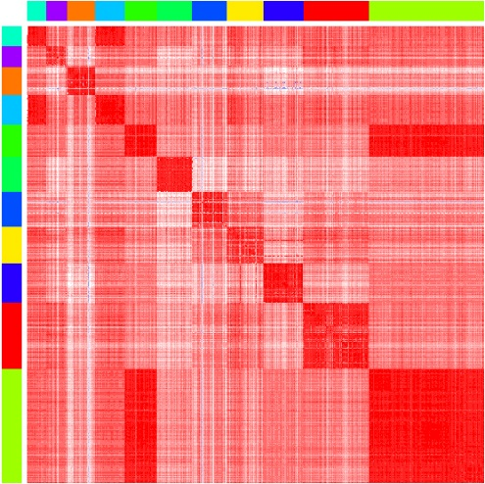
Tumor heterogeneity revealed by genome-wide DNA methylation
Lung Cancer R=0.90
KIRC and KIRP
Kidney Clear Cell Carcinoma
Kidney Papillary Cell Carcinoma
Liver Cancer R=0.84
Kidney
R=0.97
KIRC/KIRP R=0.92
LUAD UCEC COAD LUSC KIRP LIHC PRAD HNSC THCA BRCA KIRC
Cancer samples
Normal samples
Guo, unpublished data

Slide 15
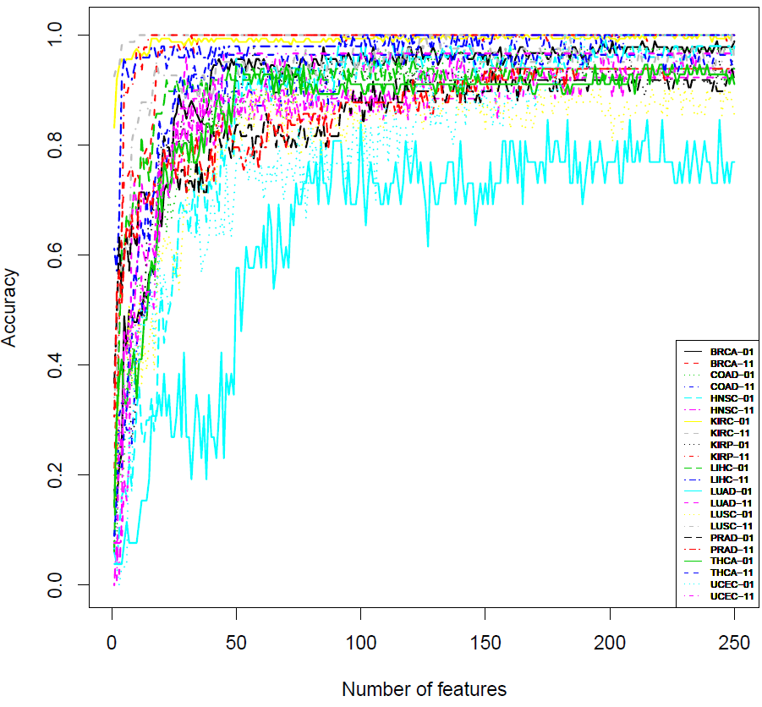
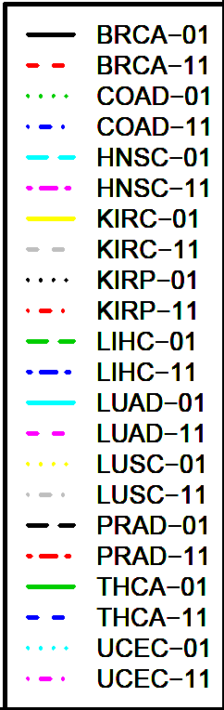
Multi-label Classification to Pan-cancer with Random Forest Method
 | Variable=25 |  |  | Variable=75
 | Sen | Spe | Acc | Sen | Spe | Acc
BRCA | 0.85 | 0.97 | 0.91 | 0.94 | 1.00 | 0.97
COAD | 0.72 | 0.85 | 0.78 | 0.92 | 0.89 | 0.91
HNSC | 0.58 | 0.72 | 0.65 | 0.94 | 0.90 | 0.92
KIRC | 0.99 | 1.00 | 0.99 | 0.99 | 1.00 | 0.99
KIRP | 0.84 | 1.00 | 0.92 | 0.91 | 1.00 | 0.96
LIHC | 0.87 | 0.96 | 0.92 | 0.92 | 0.98 | 0.95
LUAD | 0.27 | 0.73 | 0.50 | 0.58 | 0.85 | 0.71
LUSC | 0.63 | 0.93 | 0.78 | 0.78 | 0.93 | 0.85
PRAD | 0.78 | 0.82 | 0.80 | 0.86 | 0.84 | 0.85
THCA | 0.79 | 0.88 | 0.83 | 0.88 | 0.96 | 0.92
UCEC | 0.57 | 0.77 | 0.67 | 0.77 | 0.97 | 0.87
25-75 CpGs provide ~80% accuracy to 22 sample types
Guo, unpublished data

Slide 16
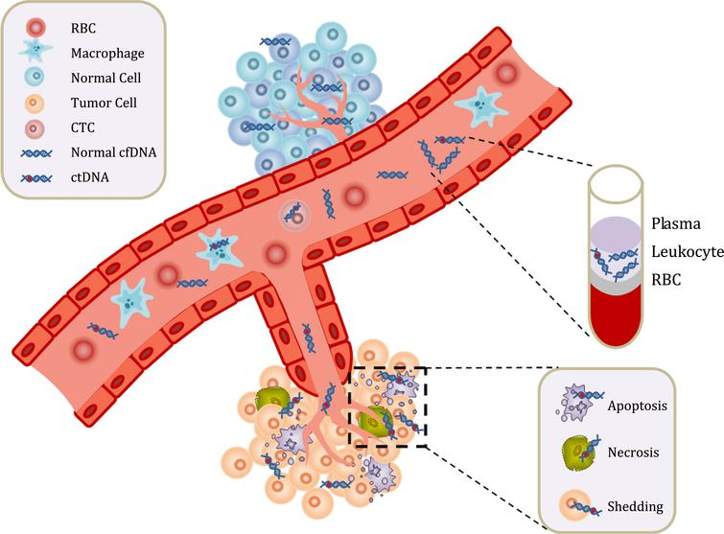
Cell-free Circulating Tumor DNA (ctDNA) in human Carcinoma
ctDNA 10-200ng/ul Plasma
Non-random distributed, repeat regions
Non-invasive diagnosis and real-time surveillance
Circulating tumor DNA, Wikipedia, 2019
Guo, unpublished data

Slide 17
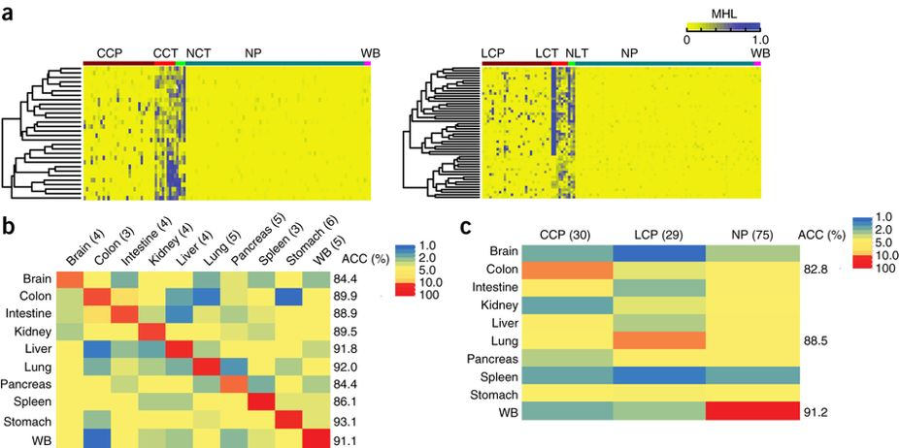
Prediction of cancer tissue of origin from plasma DNA using cell-free DNA methylation
Application of the prediction model to plasma samples from patients with CRC (n = 30) or LC (n= 29) and from healthy individuals (n = 75)
Guo, Nature Genetics, 2017

Slide 18
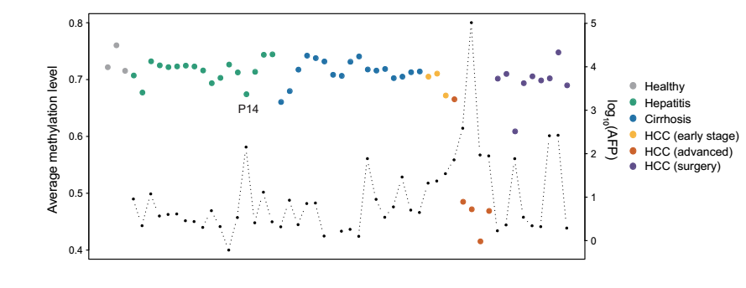
Cell-free DNA Methylation levels reveals long-term health status
Long-region average methylation level from low-pass genome-wide DNA methylation sequencing data
2 Mbp Genome-window
Guo, unpublished data

Slide 19
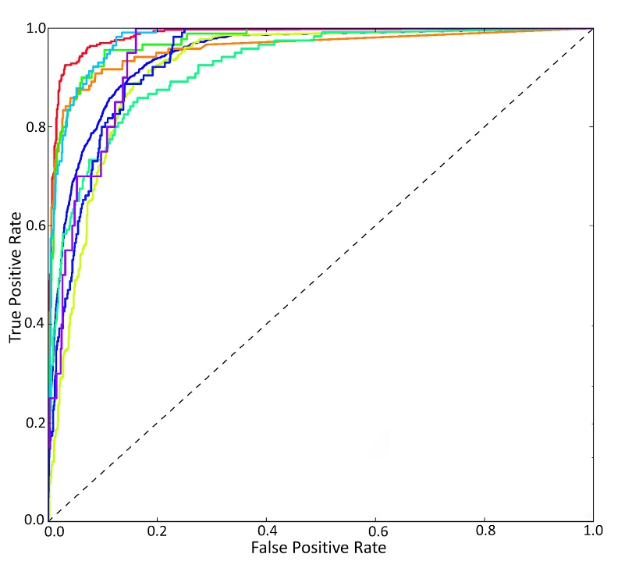
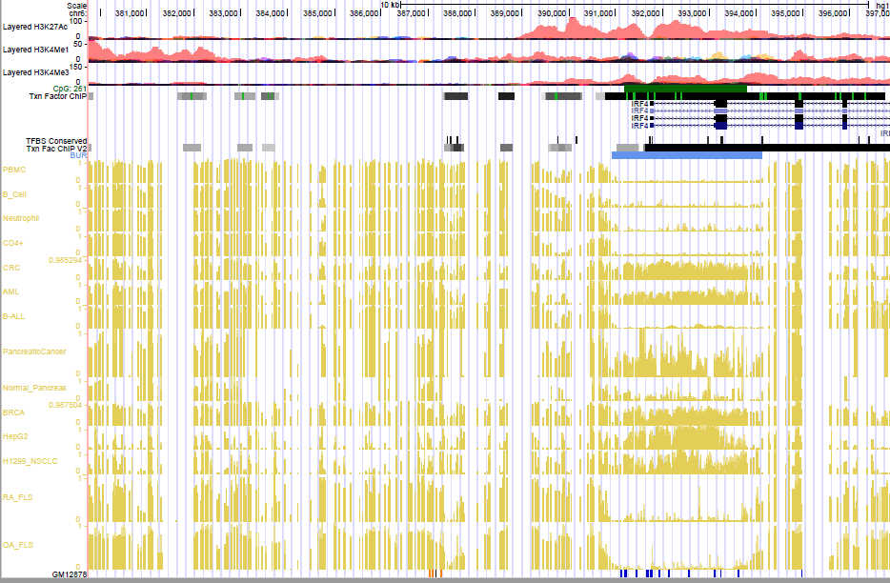
Cancer diagnosis panels to be validated in the plasma using cell-free DNA methylation
GBM: IRF4, MGMT, CD133, ARF1,C2orf40,
NULL
BRCA
COAD
GBM
HCC
KIRC
LUAD
LUSC
PRAD
UCEC
PBMC
B-cells
Neutrophil
CD4+
CRC
AML
BML
GBM
BCRA
HepG2
NSLCL
RA
OA
Brain
TCGA+GEO: 11846 cancer samples
Support vector machine (five-fold cross-validation)

Slide 20

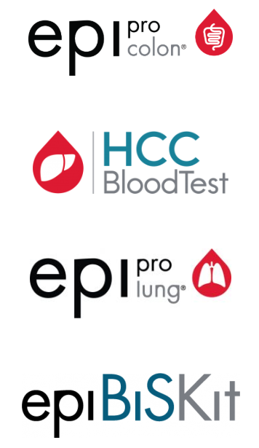

Future work
US, FDA
US20070048738A1
Prostate cancer
Glioblastoma cancer
Pancreatic cancer
Chronic lymphocytic leukemia

Slide 22
Thanks

